Slide 1

Machine Learning
Supervised Learning

Slide 2

Meet 6: Supervised Learning
Outline
The Difference between Regression and Classification
Regression Algorithms
Classification Algorithms
Types of Classification Problems

Slide 3
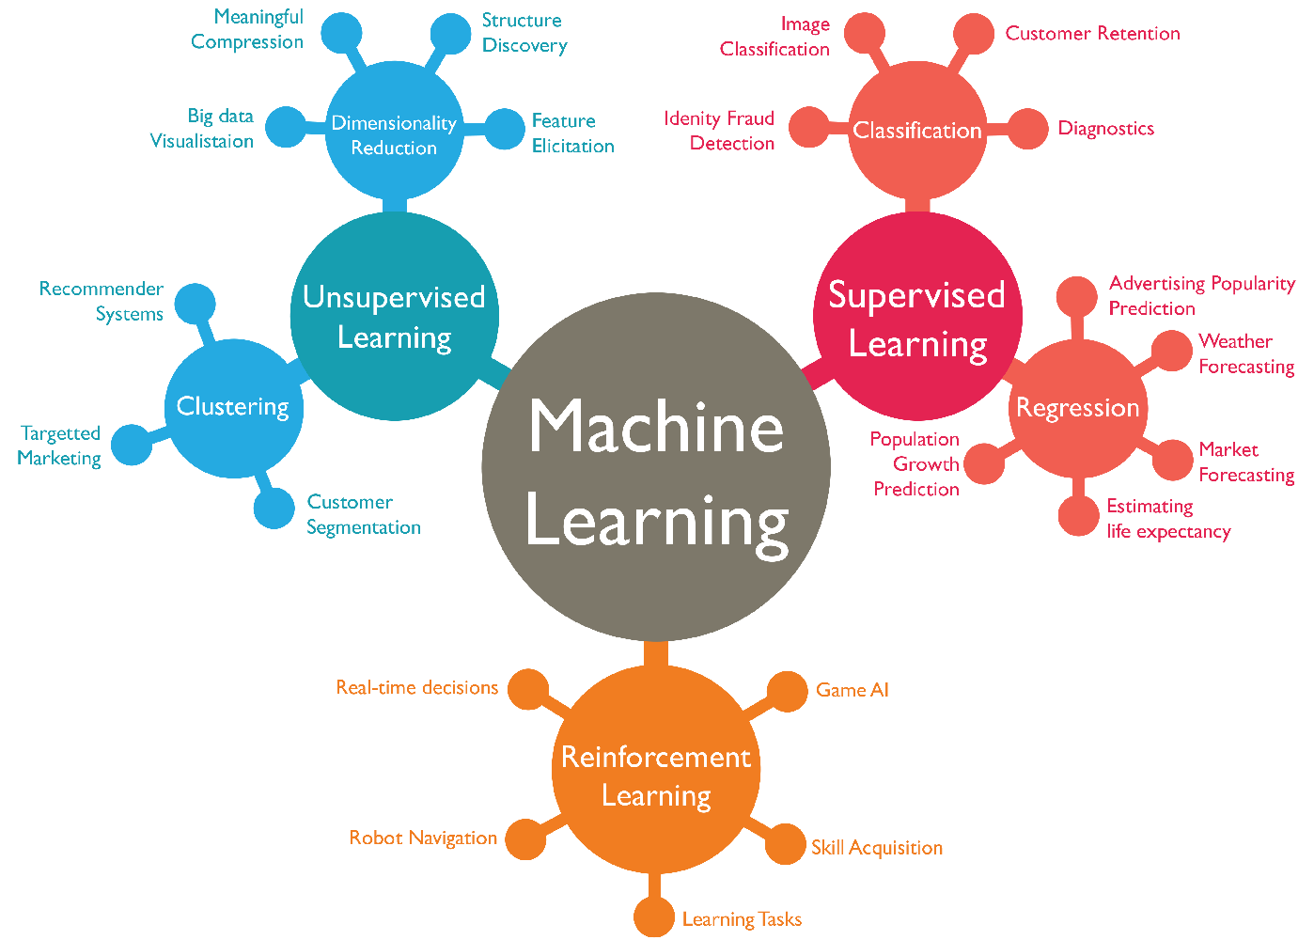
The Difference between Regression and Classification
Source : https://www.wordstream.com/blog/ws/2017/07/28/machine-learning-applications

Slide 4
The Difference between Regression and Classification
Classification is the process of predicting a discrete class label or category.
Regression is the process of predicting a continuous value as opposed to predicting a categorical value in Classification.
The main difference between them is that the output variable in:
Regression is numerical (or continuous), while
Classification is categorical (or discrete)

Slide 5
Regression Algorithms
Linear Regression (describing linear relationship)
Polynomial Regression (describing curvilinear relationships, wether it’s quadratic, cubic, or higher order)
Ridge Regression (analyzing multiple regression data that suffer from multicollinearity)
etc.

Slide 6
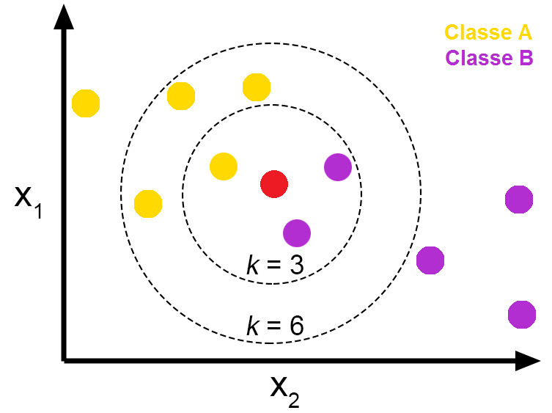
Classification Algorithms
K-Nearest Neighbor (classify classes using the majority response value from the K nearest neighbors)
Support Vector Machine (classify classes by finding the optimal hyperplane)
Decision Tree (classify classes by building a decision tree according to the if-else conditions)
etc.
K-Nearest Neighbor
Source : https://medium.com/@16611110/klasifikasi-k-nn-menggunakan-data-tooth-growth-di-r-ec18148f1cd9

Slide 7
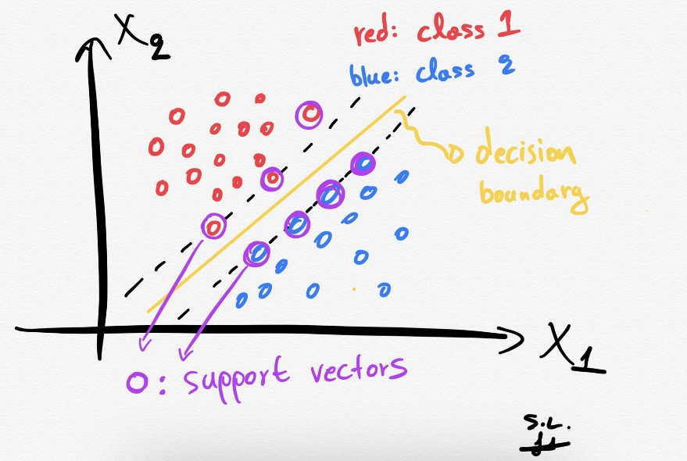
Classification Algorithms
K-Nearest Neighbor (classify classes using the majority response value from the K nearest neighbors)
Support Vector Machine (classify classes by finding the optimal hyperplane)
Decision Tree (classify classes by building a decision tree according to the if-else conditions)
etc.
Support Vector Machine
Source : https://towardsdatascience.com/support-vector-machines-svm-clearly-explained-a-python-tutorial-for-classification-problems-29c539f3ad8

Slide 8
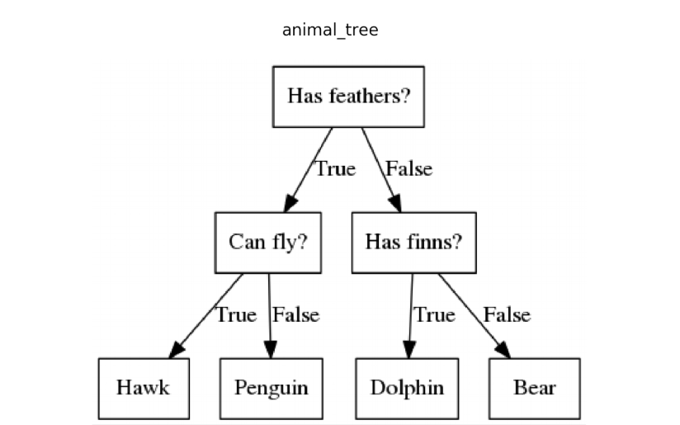
Classification Algorithms
K-Nearest Neighbor (classify classes using the majority response value from the K nearest neighbors)
Support Vector Machine (classify classes by finding the optimal hyperplane)
Decision Tree (classify classes by building a decision tree according to the if-else conditions)
etc.
Decision Tree
Source : https://towardsai.net/p/programming/decision-trees-explained-with-a-practical-example-fe47872d3b53

Slide 9
Types of Classification Problems
There are 3 types of classification problems:
Binary Classification
Multi-class Classification
Multi-label Classification

Slide 10
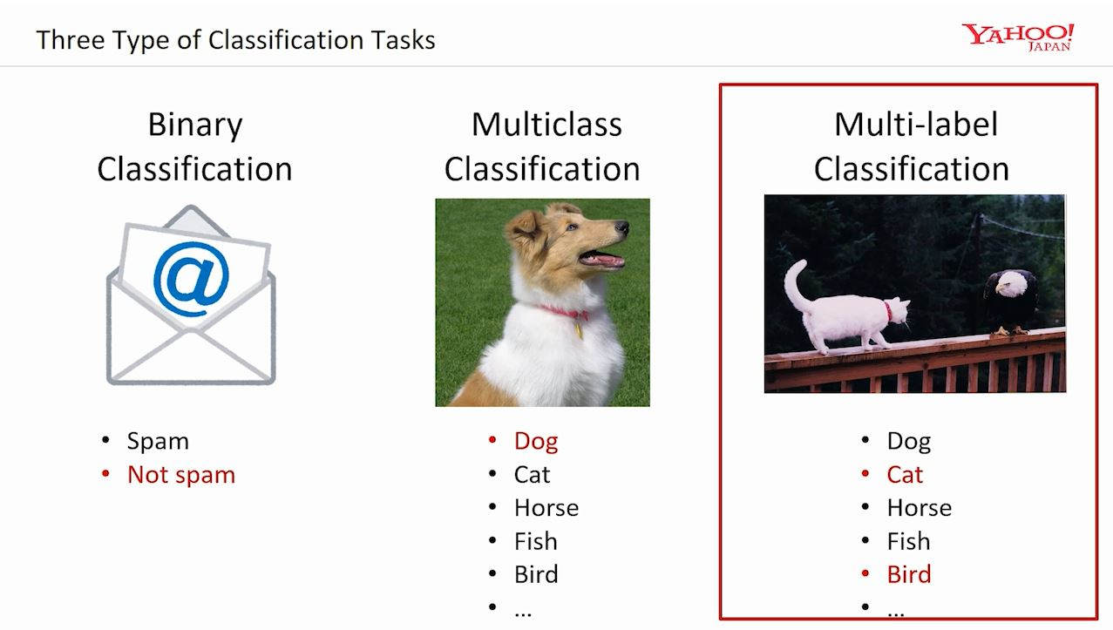
Types of Classification Problems
Source : https://www.microsoft.com/en-us/research/uploads/prod/2017/12/40250.jpg

Slide 11
Types of Classification Problems
Source : https://www.microsoft.com/en-us/research/uploads/prod/2017/12/40250.jpg

